Slide 1
ANALYSIS FOR THE NEW MICROSOFT MOVIE STUDIO

Slide 2
ANALYSIS FOR THE NEW MICROSOFT MOVIE STUDIO

Slide 3
Table of contents
Project overview
Objectives
Data Analysis
Conclusion
Recommendations

Slide 4
Project Overview
This project enables Microsoft to have a glimpse of the film industry market and we are using data from imdb, the movie ratings on movie box also play a major role in the visualization of the data obtained from a range of genres that are individually rated, this helps Microsoft know which genre to choose to produce in order to be successful in the industry the use of charts extracted from our findings makes it easier for them to compare the differences in the genres making them fulfil the needs of their audience.

Slide 5
Objectives of the analysis
To identify the most popular genres in terms of sales.
To identify the most popular genres in terms of the average ratings.
To identify the correlation between the average rating and the sales
To identify the most sold genres domestically and internationally
To identify the most sold genres domestically.
To identify the most sold genres internationally.

Slide 6
Data Analysis
In-depth exploration of the dataset was conducted using statistical measures, visualizations and techniques. The project identified patterns, correlations, and trends within the movie data. The analysis focused on genres, sales, and ratings, providing actionable insights for strategic decision-making.

Slide 7
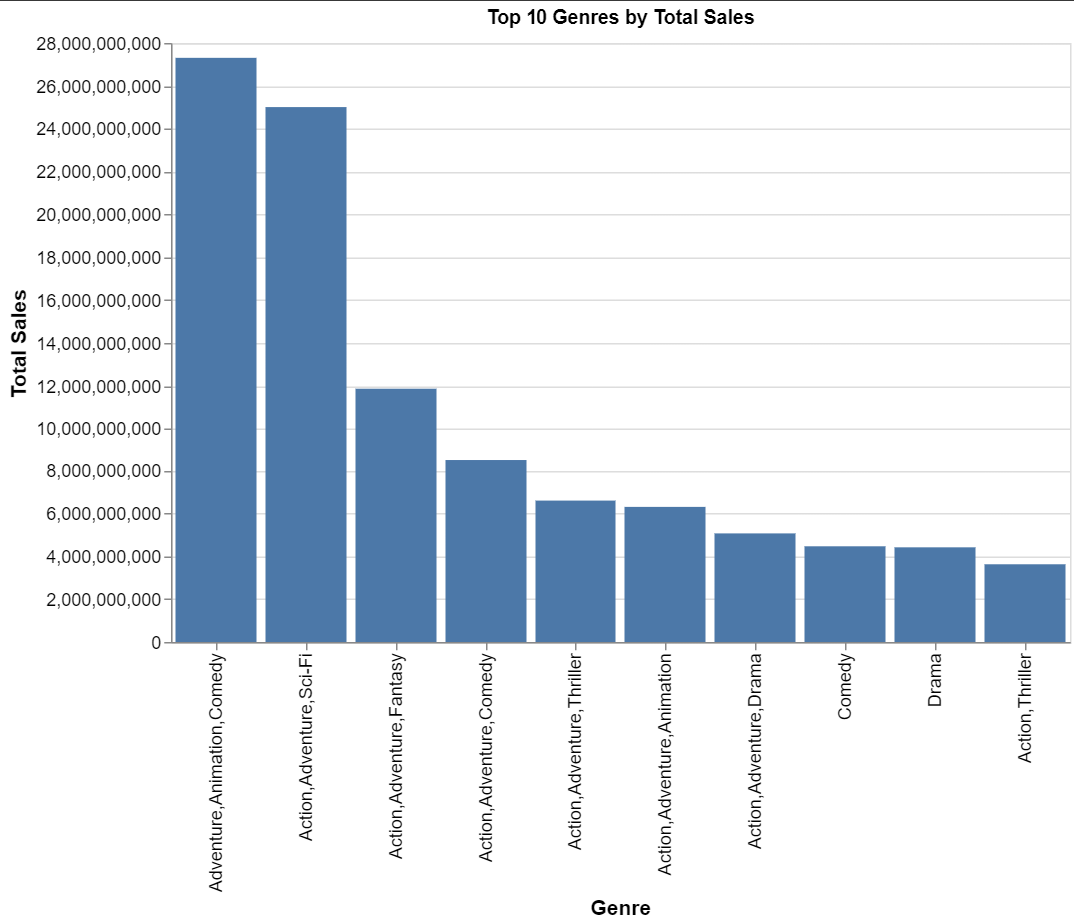
most popular genres in terms of sales.
From the graph we are able to see the most popular genre to be Adventure,Animation,Comedy the second one being Action,Adventure,Sci-Fi and the third one to be Action,Adventure,Fantasy.

Slide 8
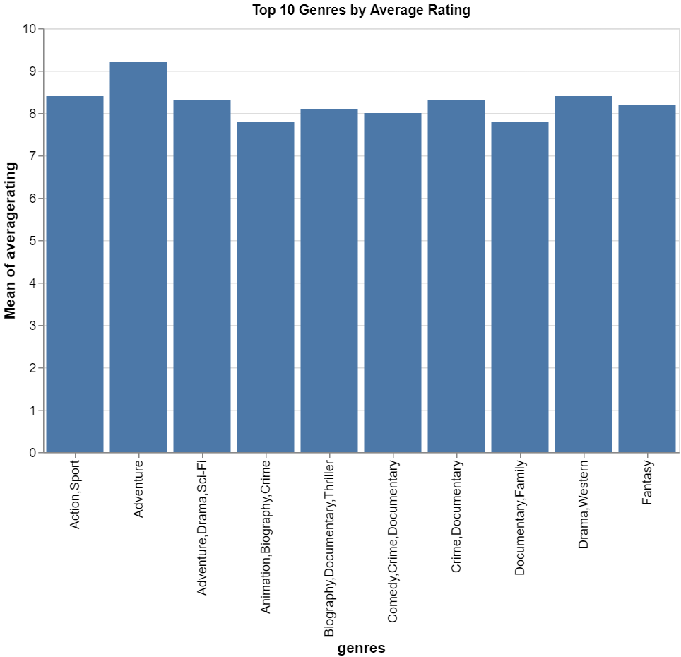
most popular genres in terms of the average ratings.
We are able to see that Adventure is the most popular genre in terms of average rating.

Slide 9
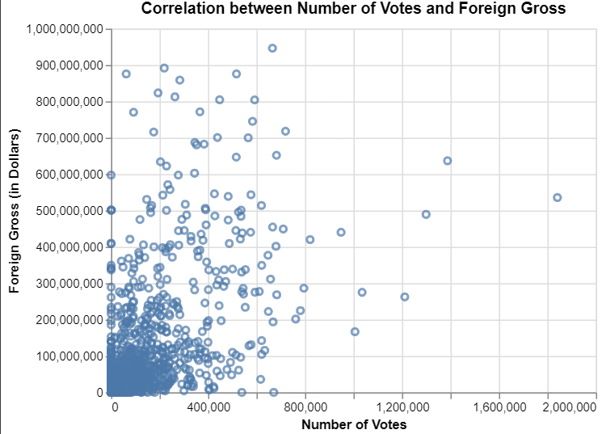
correlation between the average rating and the sales
We are able to see that most dots are in the bottom left corner meaning (few votes, low foreign gross). As you move to the top right, dots spread out (more votes, higher foreign gross). Therefore, there’s a positive connection—more votes often mean higher foreign revenue for movies with higher votes.

Slide 10
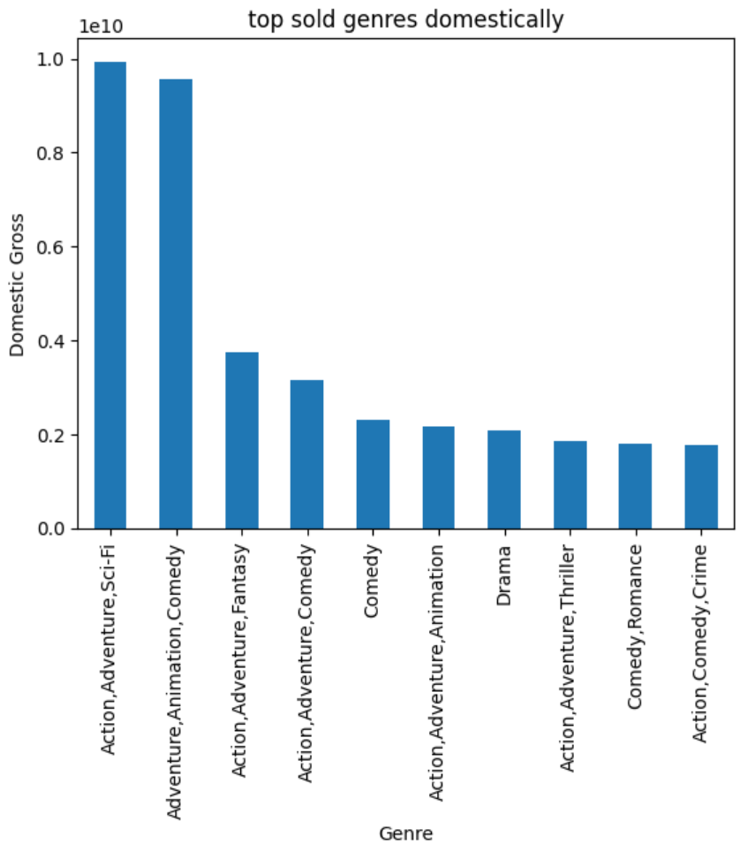
most sold genres domestically.
From the visualization above, we are able to see that Action, Adventure, Sci-Fi has been the most sold genre domestically and Action,Comedy,Crime has the least sales.

Slide 11
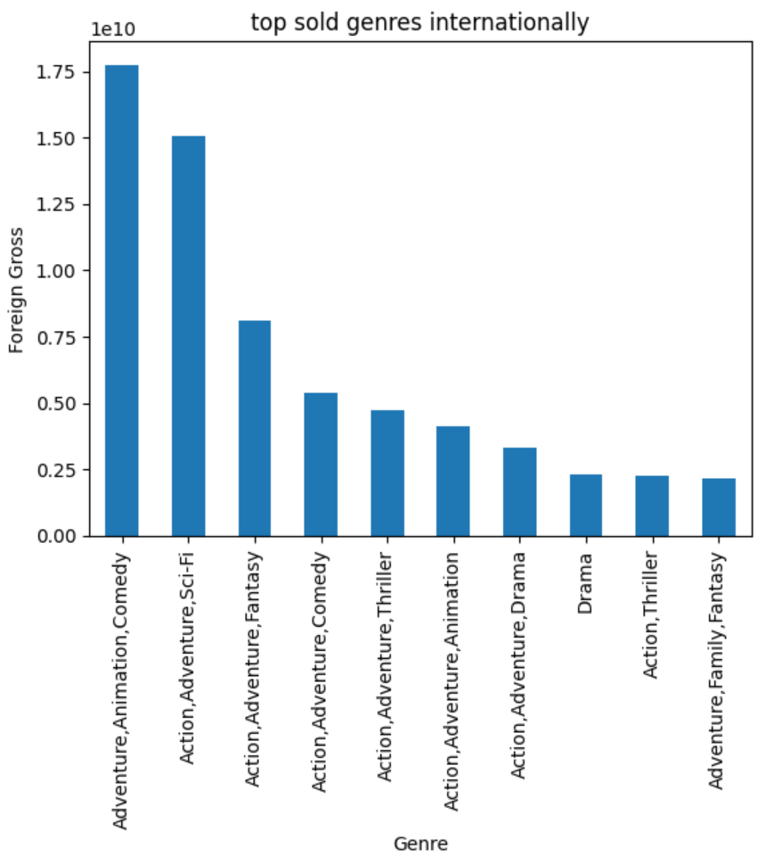
most sold genres internationally.
From the visualization above, we are able to see that Adventure,Animation,Comedy has the most sales internationally while the genre with the least sales is Adventure,Family,Fantasy.

Slide 12
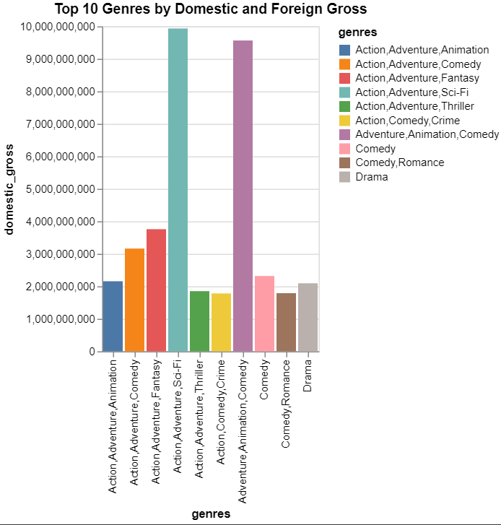
most sold genres domestically and internationally
The visualization shows that the genres that are the most sold locally are also getting high sales in the outside market and the same for the highest sold genre in the foreign markets.

Slide 13
Conclusions
The analysis resulted in the following recommendation: For the domestic audience : Focus more on producing Action, Adventure, Sci-Fi since that is what yields the highest revenue in the domestic market. For the foreign audience : Focus more on producing a film with the genre combination of Adventure, Drama and Sport since that is what yields the highest revenue in the foreign market. Based on what is most liked by the two markets: Focus on producing more Adventure themed films. Runtime has little impact on success in terms of revenue: You are therefore have the flexibility of choosing the length of your films. You can focus on compelling story regardless of runtime

Slide 14
Recommendations
1.The company should invest in Action, Adventure, Sci-Fi and Adventure,Animation,Comedy since they do well both internationally and domestically.
2.The company should look forward to working with top writers in the various fields. They should work more with Jack Kirby when producing Action, Adventure and Sci-Fi movie combination.
3.The company should invest in movies that do well both in terms domestic and foreign gross.

Slide 15
Table of contents
Project overview
Objectives
Data Analysis
Conclusion
Recommendations

Slide 16
Project Overview
This project enables Microsoft to have a glimpse of the film industry market and we are using data from imdb, the movie ratings on movie box also play a major role in the visualization of the data obtained from a range of genres that are individually rated, this helps Microsoft know which genre to choose to produce in order to be successful in the industry the use of charts extracted from our findings makes it easier for them to compare the differences in the genres making them fulfil the needs of their audience.

Slide 17
Objectives of the analysis
To identify the most popular genres in terms of sales.
To identify the most popular genres in terms of the average ratings.
To identify the correlation between the average rating and the sales
To identify the most sold genres domestically and internationally
To identify the most sold genres domestically.
To identify the most sold genres internationally.

Slide 18
Data Analysis
In-depth exploration of the dataset was conducted using statistical measures, visualizations and techniques. The project identified patterns, correlations, and trends within the movie data. The analysis focused on genres, sales, and ratings, providing actionable insights for strategic decision-making.

Slide 19
most popular genres in terms of sales.
From the graph we are able to see the most popular genre to be Adventure,Animation,Comedy the second one being Action,Adventure,Sci-Fi and the third one to be Action,Adventure,Fantasy.

Slide 20
most popular genres in terms of the average ratings.
We are able to see that Adventure is the most popular genre in terms of average rating.

Slide 21
correlation between the average rating and the sales
We are able to see that most dots are in the bottom left corner meaning (few votes, low foreign gross). As you move to the top right, dots spread out (more votes, higher foreign gross). Therefore, there’s a positive connection—more votes often mean higher foreign revenue for movies with higher votes.

Slide 22
most sold genres domestically.
From the visualization above, we are able to see that Action, Adventure, Sci-Fi has been the most sold genre domestically and Action,Comedy,Crime has the least sales.

Slide 23
most sold genres internationally.
From the visualization above, we are able to see that Adventure,Animation,Comedy has the most sales internationally while the genre with the least sales is Adventure,Family,Fantasy.

Slide 24
most sold genres domestically and internationally
The visualization shows that the genres that are the most sold locally are also getting high sales in the outside market and the same for the highest sold genre in the foreign markets.

Slide 25
Conclusions
The analysis resulted in the following recommendation: For the domestic audience : Focus more on producing Action, Adventure, Sci-Fi since that is what yields the highest revenue in the domestic market. For the foreign audience : Focus more on producing a film with the genre combination of Adventure, Drama and Sport since that is what yields the highest revenue in the foreign market. Based on what is most liked by the two markets: Focus on producing more Adventure themed films. Runtime has little impact on success in terms of revenue: You are therefore have the flexibility of choosing the length of your films. You can focus on compelling story regardless of runtime

Slide 26
Recommendations
1.The company should invest in Action, Adventure, Sci-Fi and Adventure,Animation,Comedy since they do well both internationally and domestically.
2.The company should look forward to working with top writers in the various fields. They should work more with Jack Kirby when producing Action, Adventure and Sci-Fi movie combination.
3.The company should invest in movies that do well both in terms domestic and foreign gross.

